Slide 1
Capstone Project : DoConnect
Group-3
Team members:
Vishal Bharti– Team Leader Alok Sinha Neeraj Shekhawat Spoorthi

Slide 2
GIT REPOSITORY
https://gitlab.com/vishal_1/doconnect

Slide 3
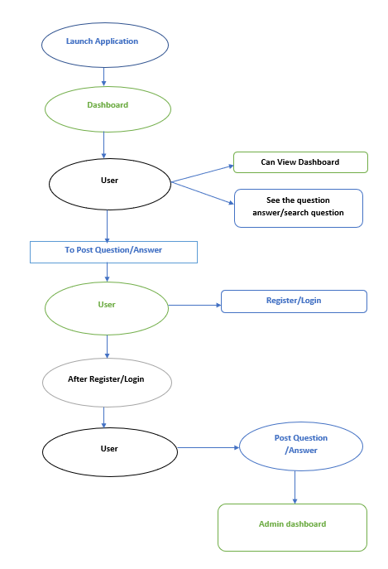
Flow diagram OF USER

Slide 4
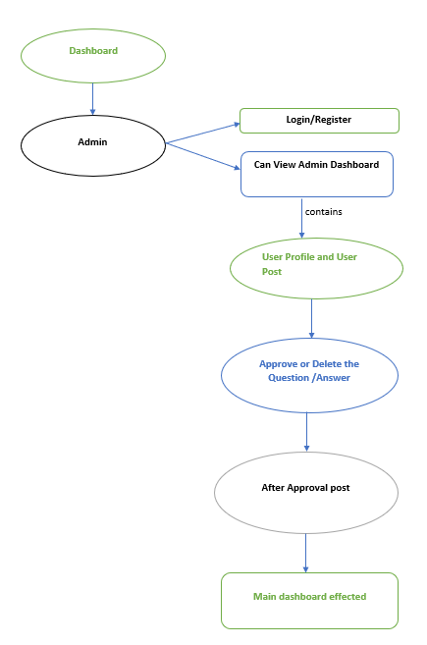
Flow diagram OF ADMIN

Slide 5
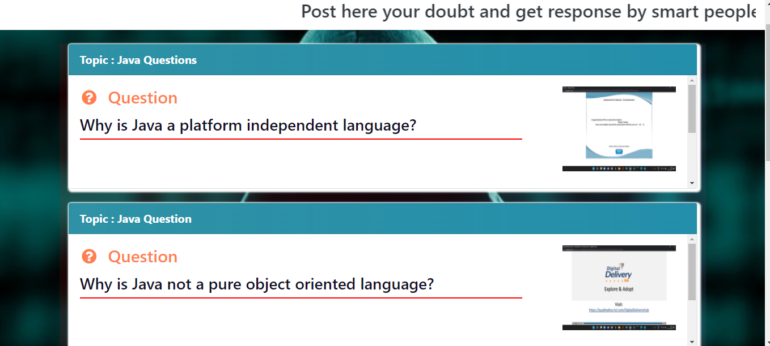
System Features
Homepage

Slide 6
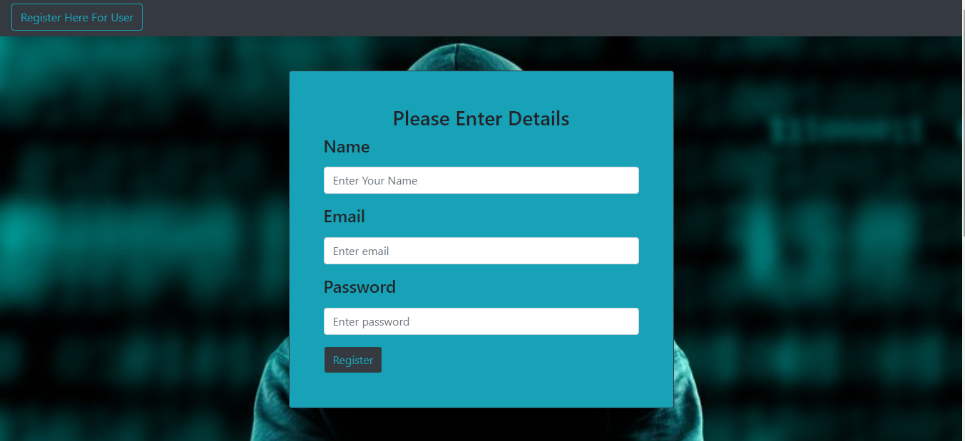
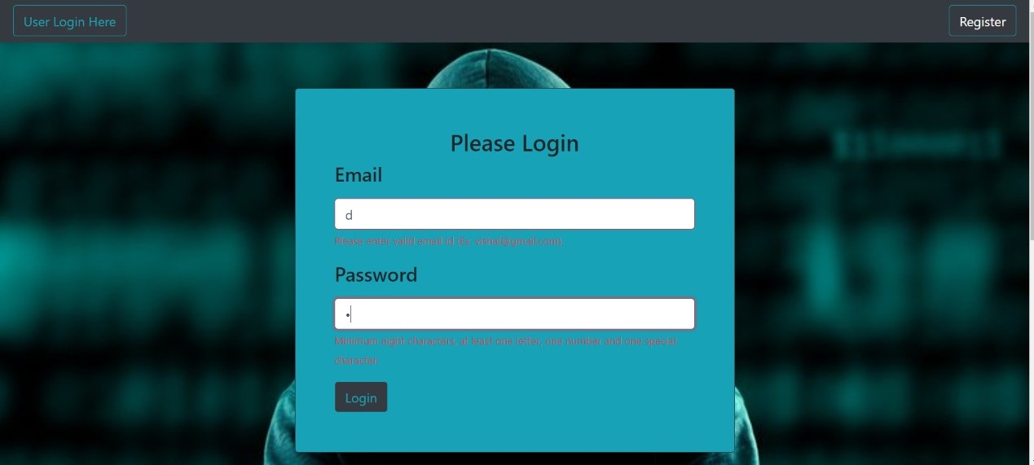
User Interface

Slide 7
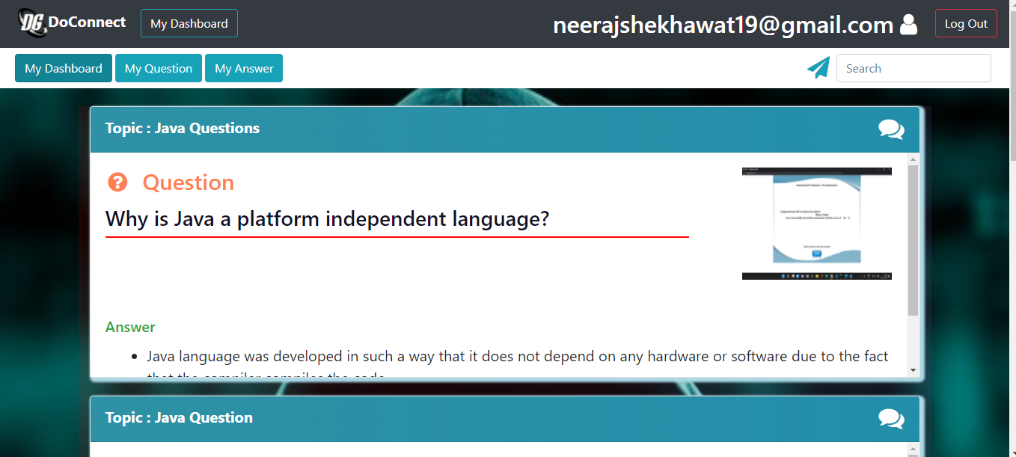
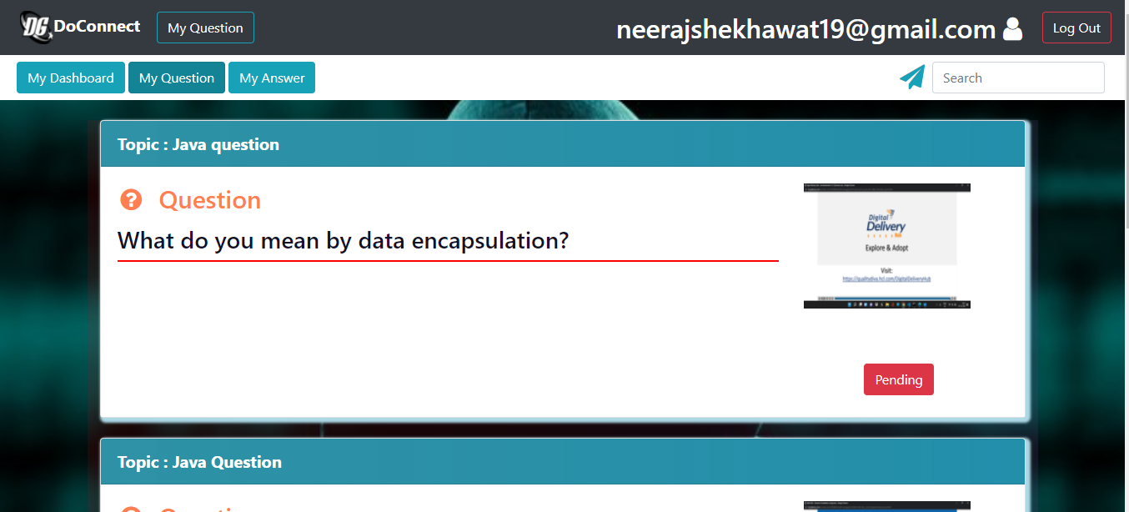
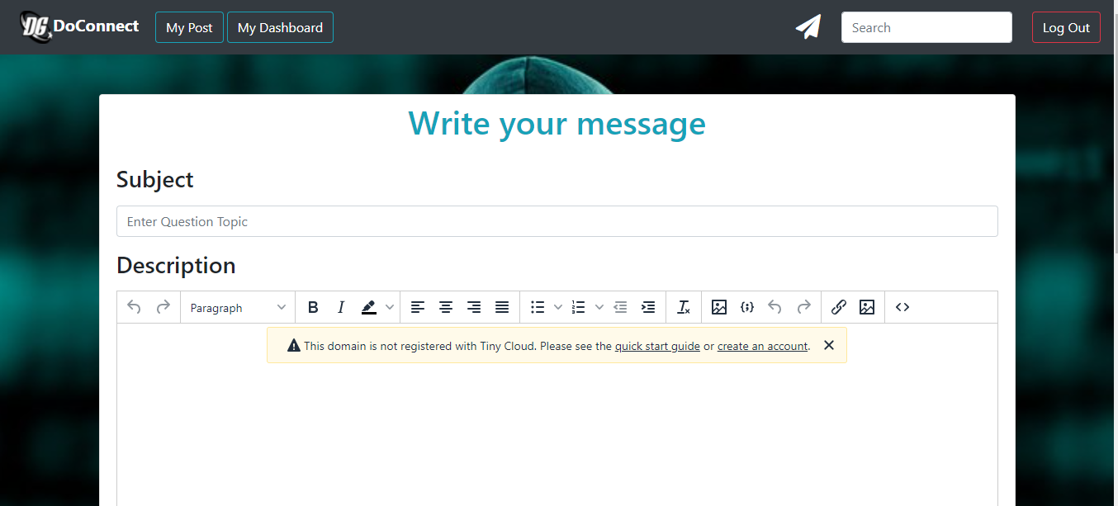

Slide 8
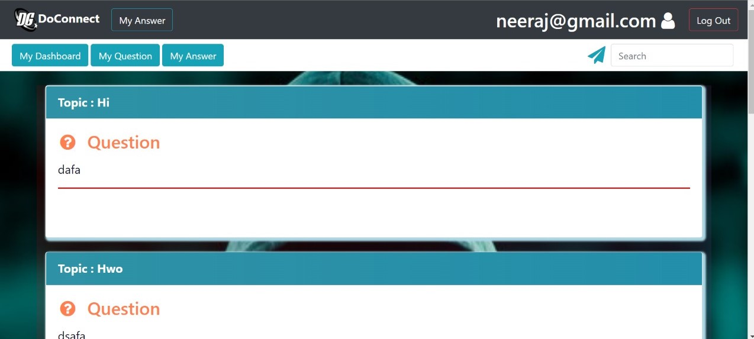
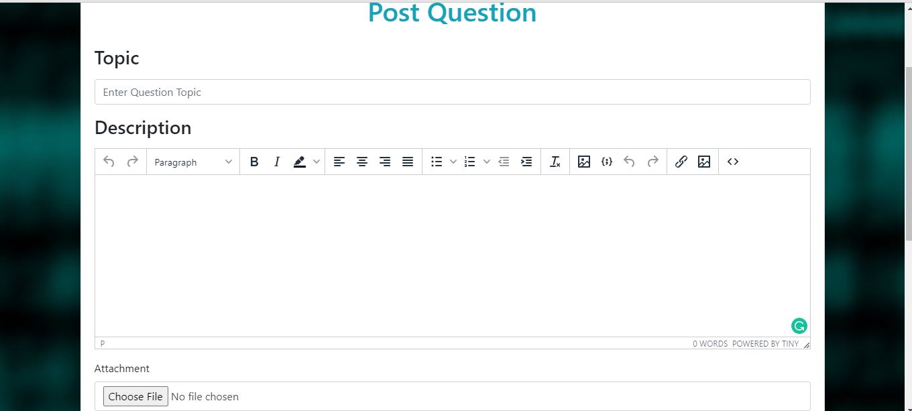

Slide 9
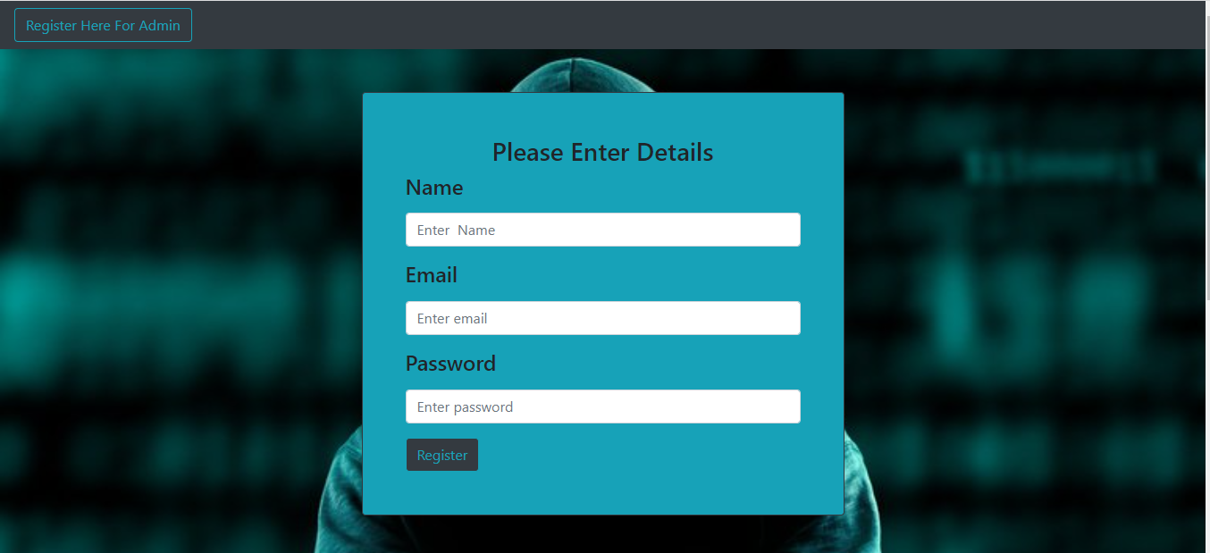
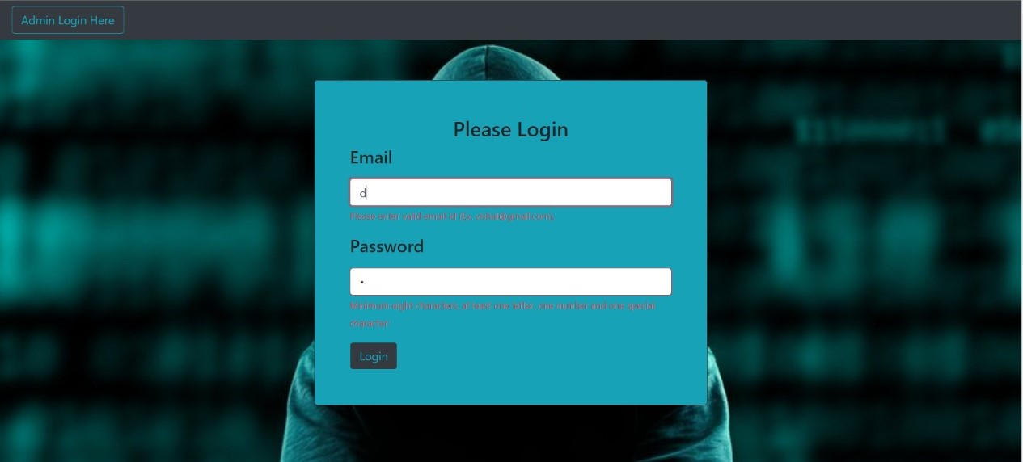
Admin Interface

Slide 10
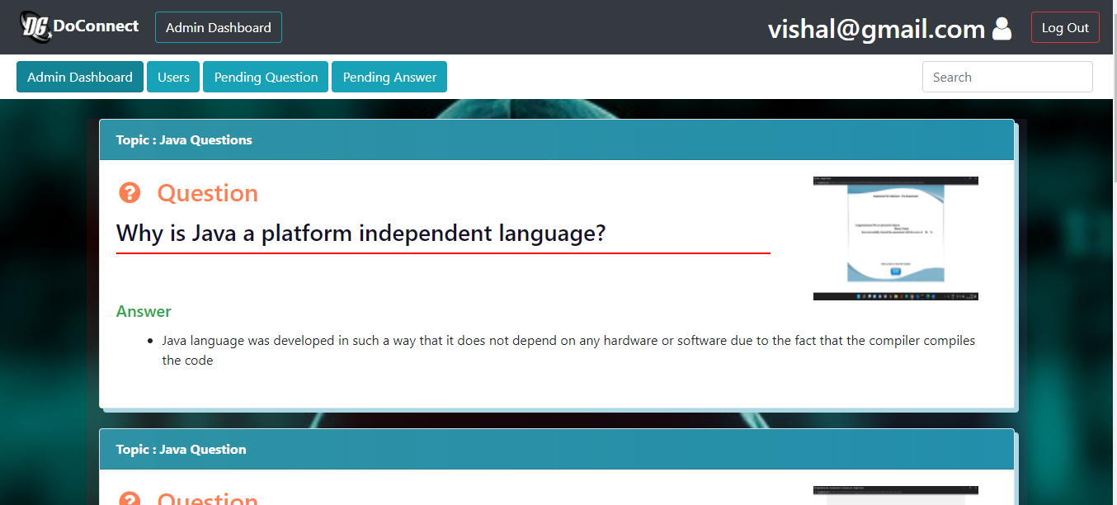
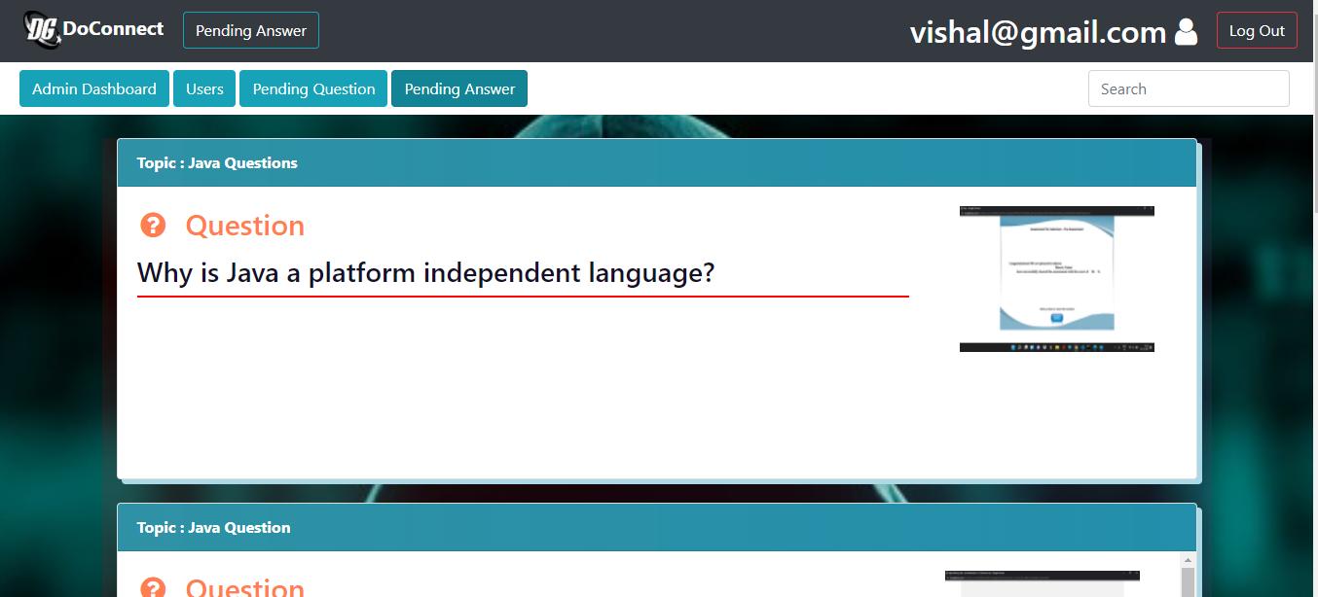
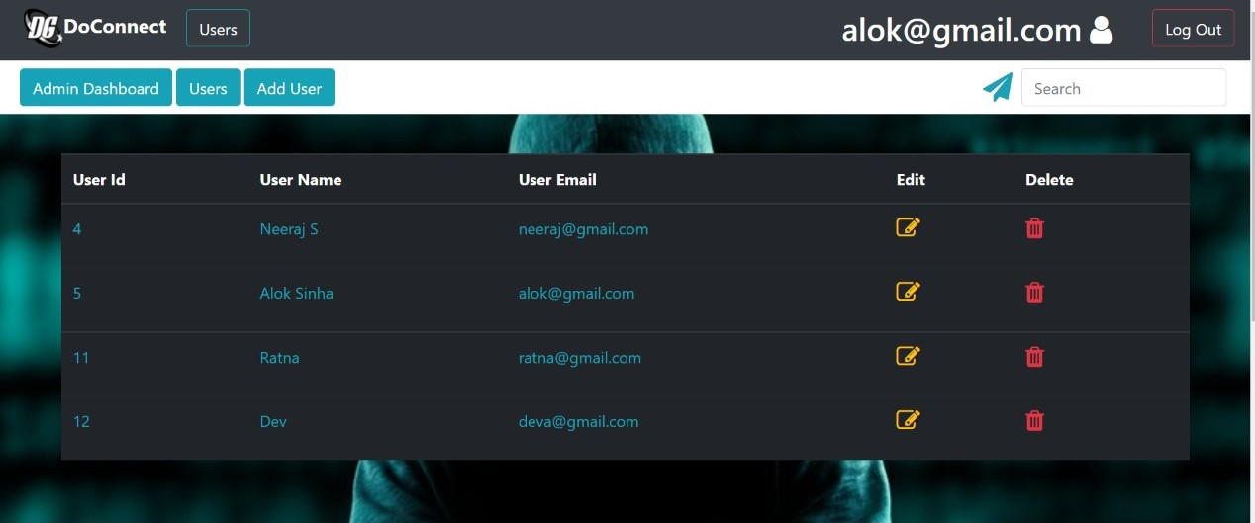

Slide 12
DATABASE STRUCTURE
DATABASE – DoConnect
TABLES:-
User bean
Question Table
Question_Answer Table
Answer Table
Chatting Table

Slide 13
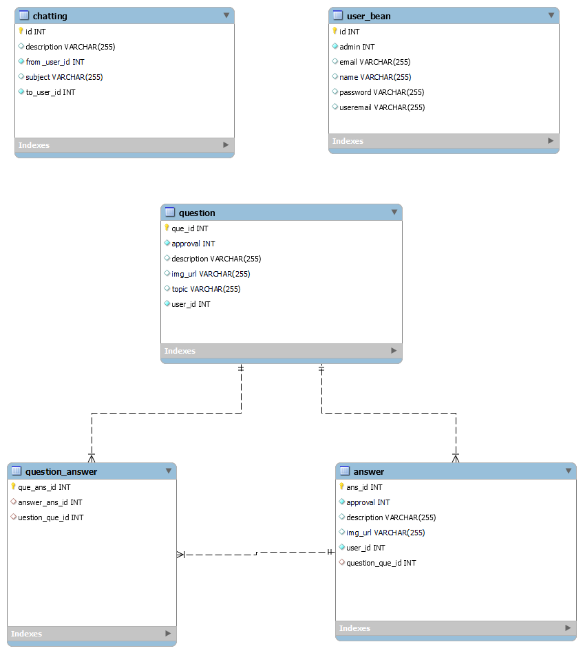
E-R Diagram

Slide 14
MICROSERVICE STRUCTURE
Database
EurekaServer
doConnectAdminService
doConnectUser
Service
Angular(UI)

Slide 15
FOLDER STRUCTURE
FOLDER NAME – DoConnect
doadminMicroservice
douserMicroservice
EurekaServer
Angular 11

Slide 16

Thank You !!!

